Slide 1
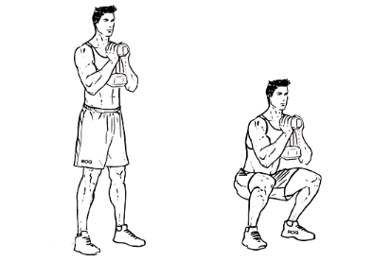
Background
A healthy lower body is both functionally healthy and aesthetically-pleasing
The goblet squat :
A front-loaded squat variation promoting upright posture
“Now, does varying weights & depths matter?”
Research Aim
Fig 1. Goblet Squat (WorkOutLabs.com)
To determine if squat depth and external load influence:
1. Hip & Knee joint moments
2. Peak muscle activation patterns (Glute Max, Vastus)
Hanif Rachmadani – z5715919

Slide 2
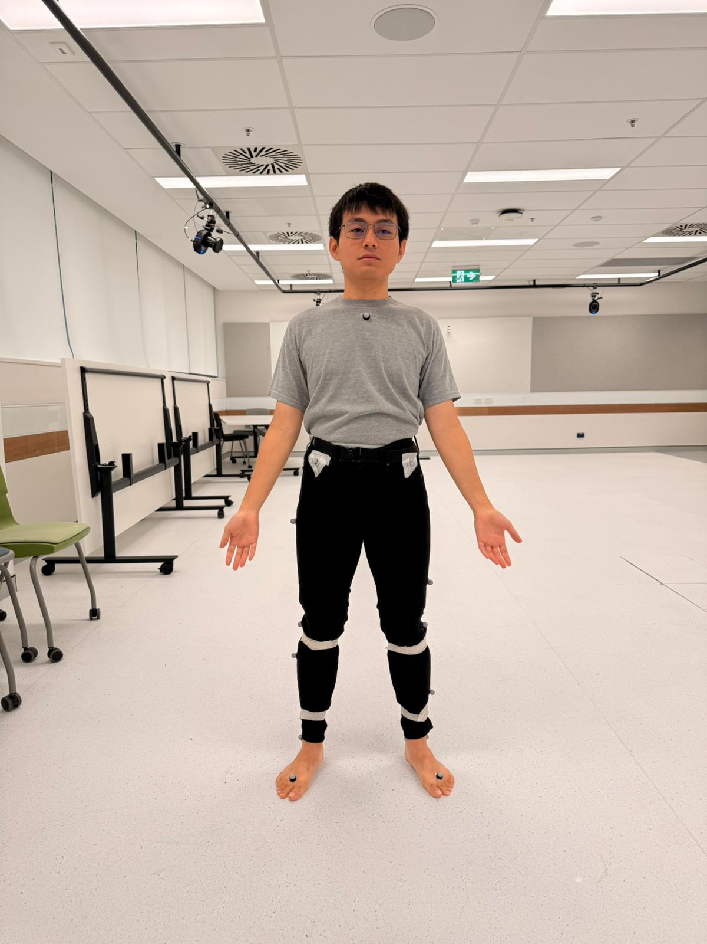
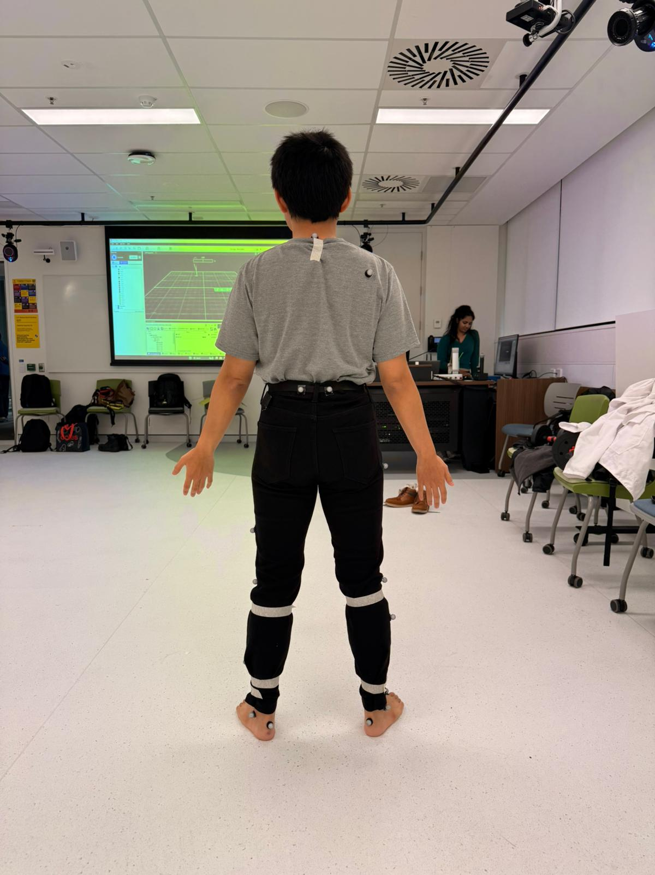
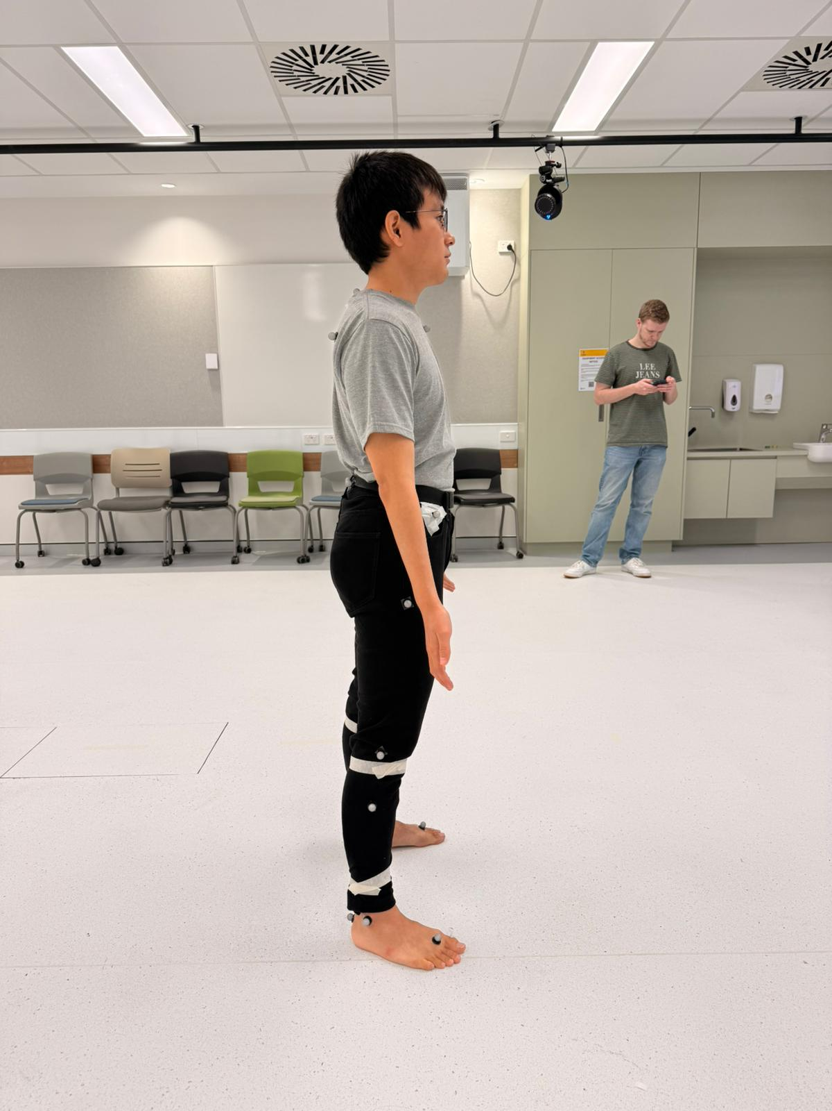
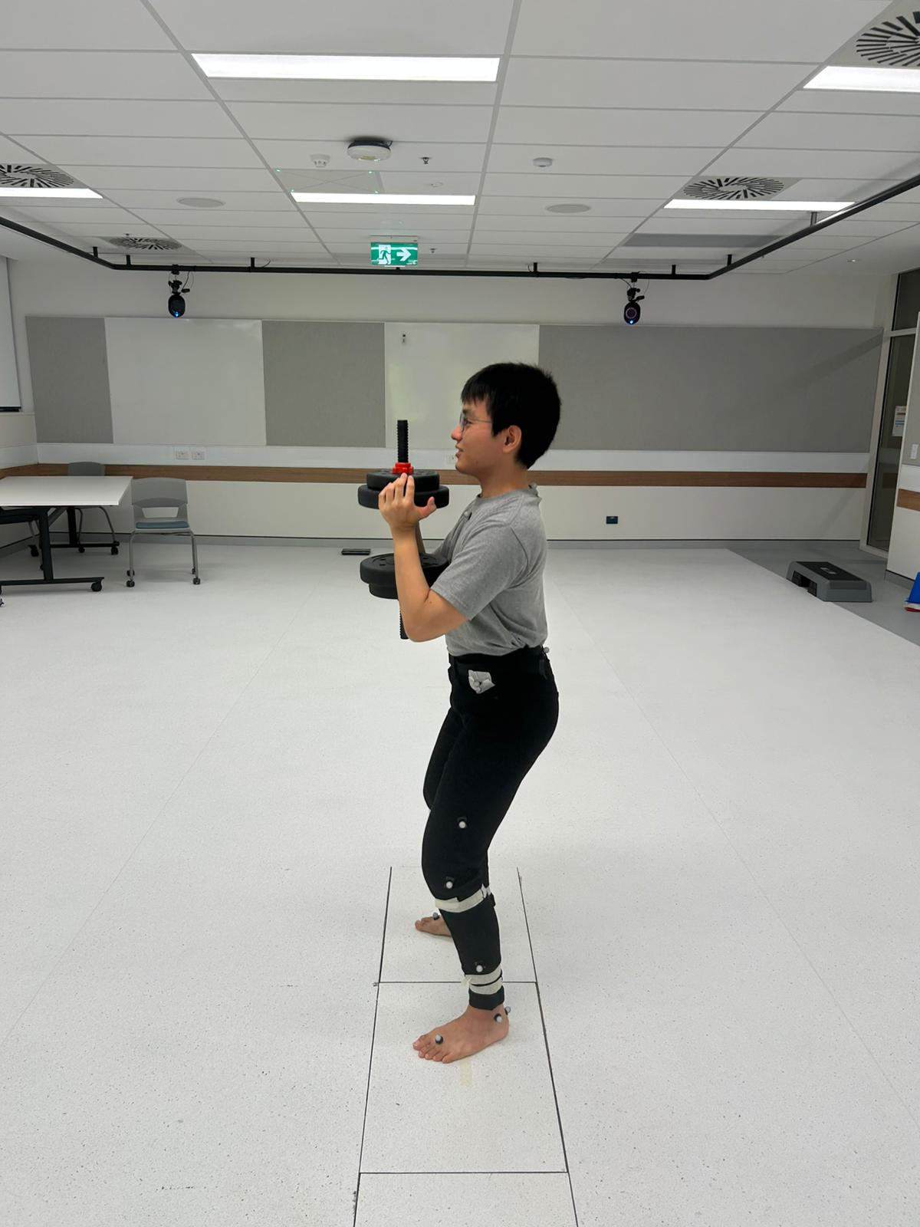
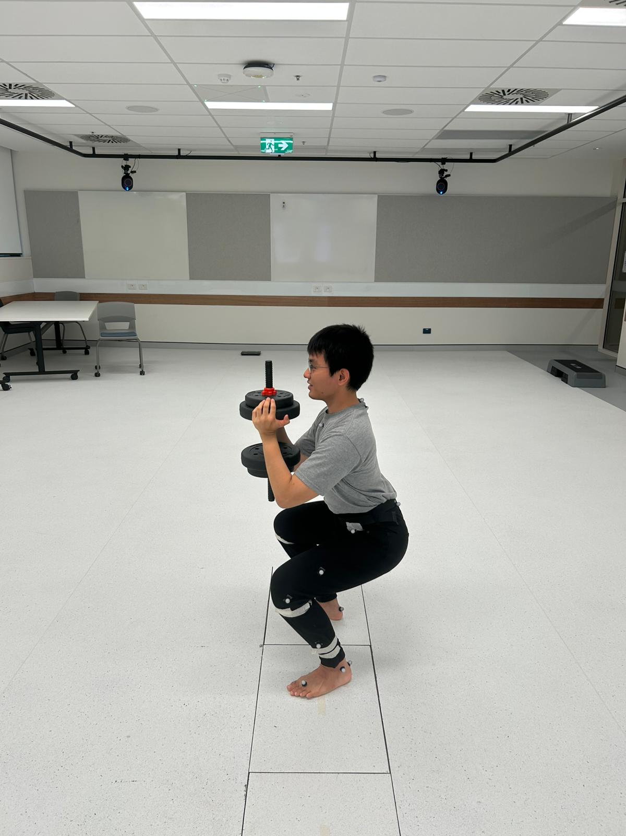
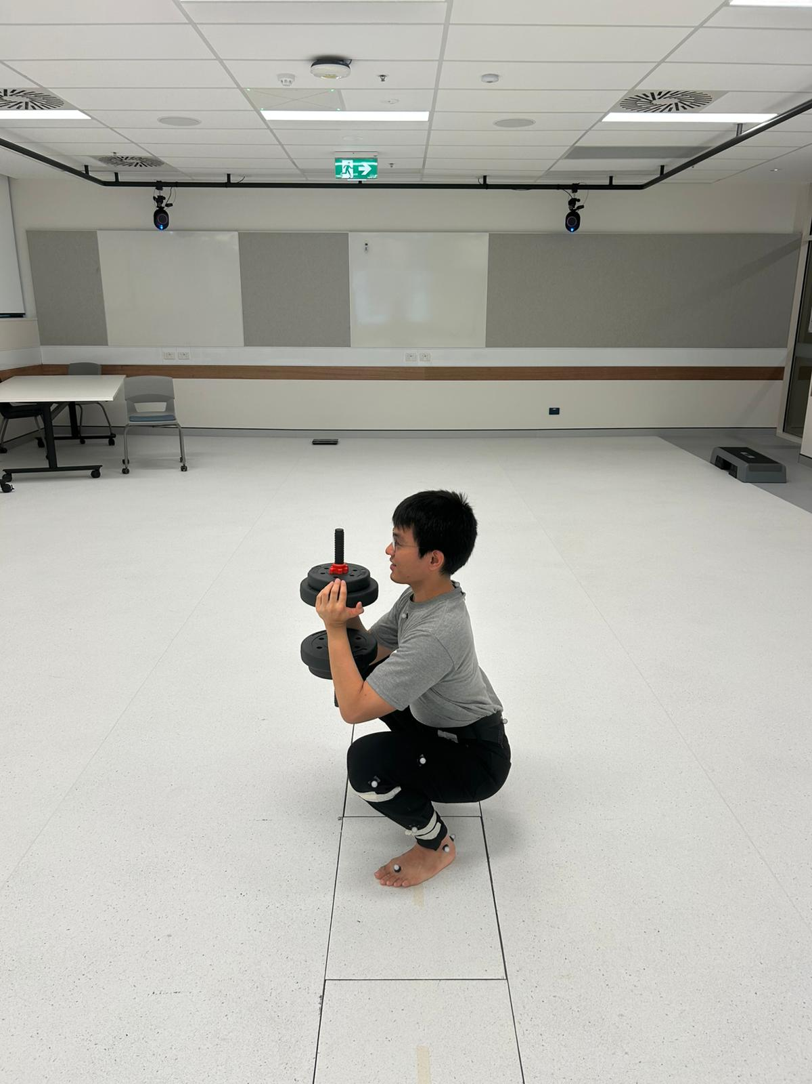
Methods
Participants : single-subject repeated trials (n=3)
Conditions :
Depths : Shallow (<90⁰), Medium (~90⁰), Deep (>90⁰)
Weights : 2.5 Kg, 5.0 Kg, 7.5 Kg
Total data : 3 x 3 x 3 = 27 trials
Processing :
Vicon, Mokka, Python (OpenSim API, Pandas, Matplotlib)
Joints of Interest : Hip & Knee
Muscles of Interest : Gluteus Maximus & Vastus
Analysis Performed :
Model Scaling
Inverse Kinematics (IK)
Inverse Dynamics (ID)
Reduce Residuals (RRA)
Computed Muscle Control (CMC)
Processing & Statistics (Normalization, Pearson Correlation)
Fig 2. Subject (me)
Fig 3. Shallow, Medium, and Deep Goblet Squats
Hanif Rachmadani – z5715919

Slide 3
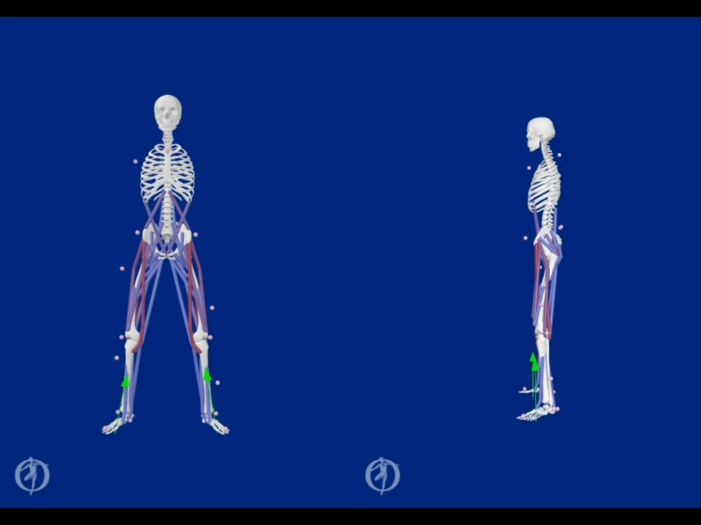
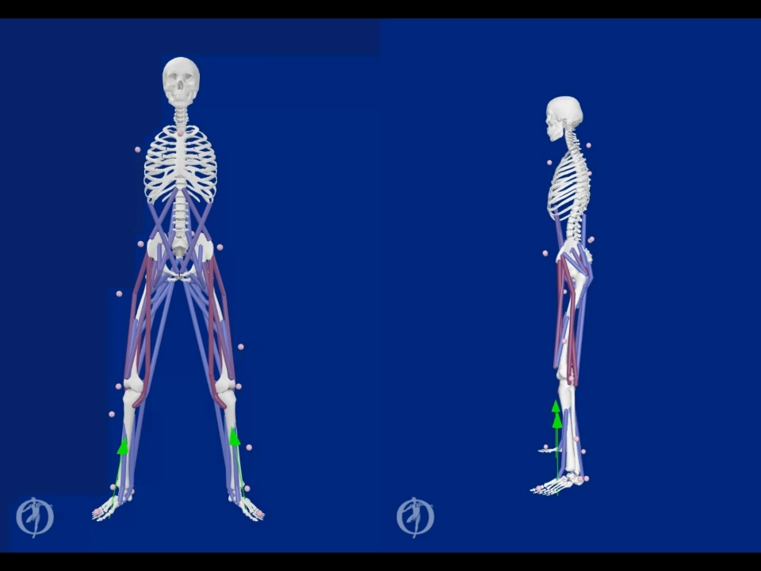
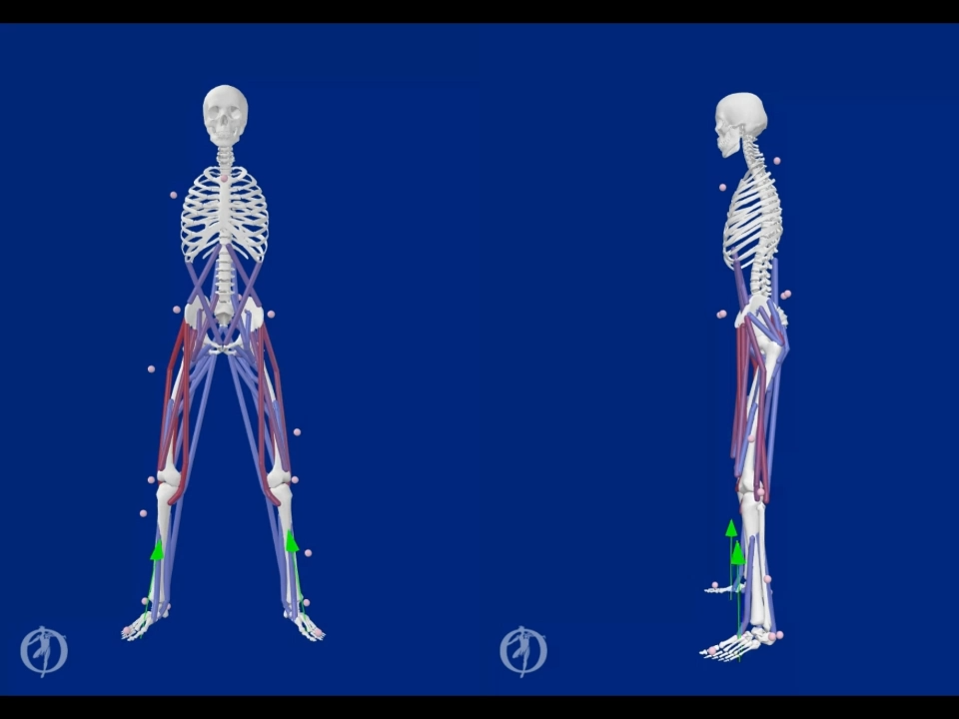
Results
Vid 1. Deep Squat
Vid 2. Medium Squat
Vid 3. Shallow Squat
Hanif Rachmadani – z5715919

Slide 4
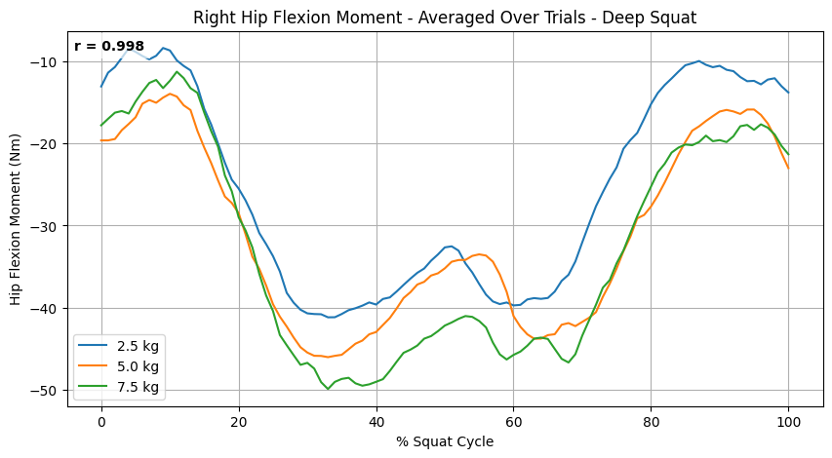
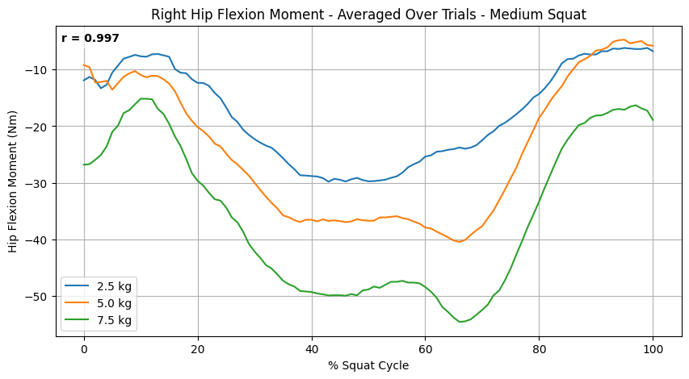
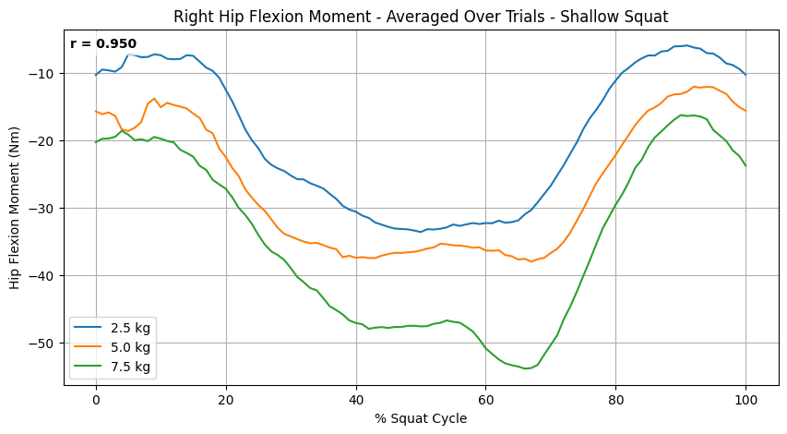
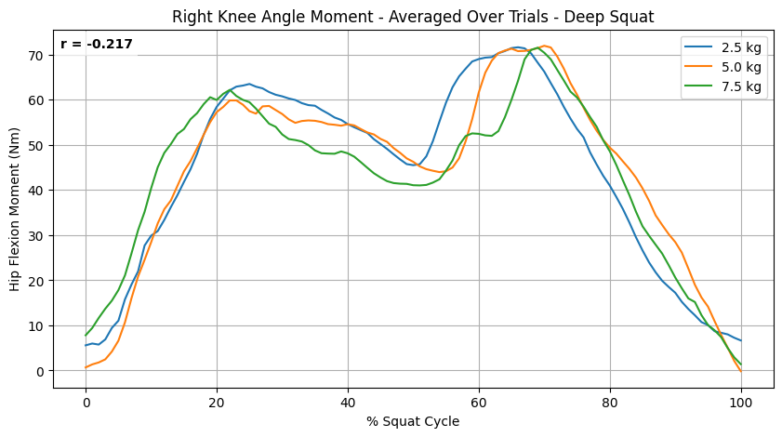
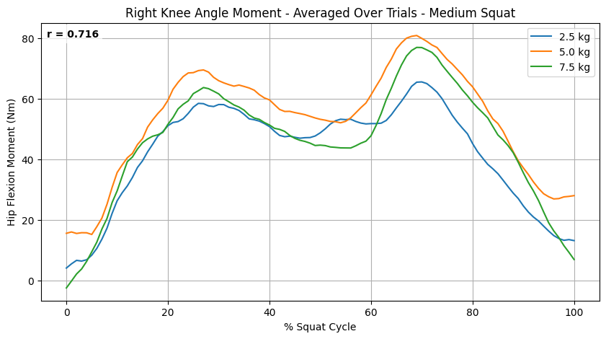
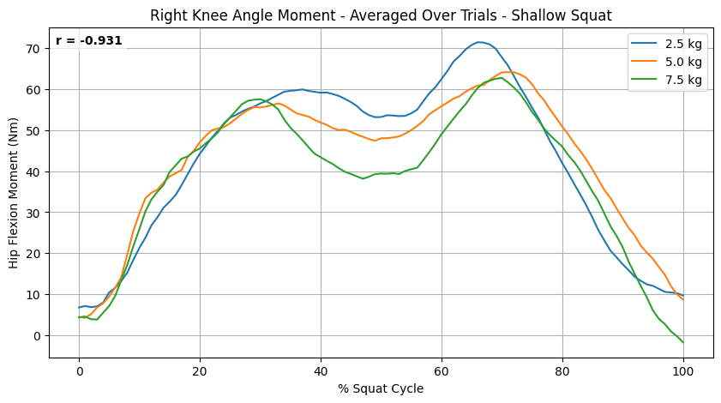
Results
Fig 4. Right Hip Flexion Moment Across Loads: Deep, Medium, Shallow
Vid 1. Deep Squat
Vid 2. Medium Squat
Fig 5. Right Knee Angle Moment Across Loads: Deep, Medium, Shallow
Depth | Hip Moment | Knee Moment
Deep | r = 0.998 | r = -0.217
Medium | r = 0.997 | r = 0.716
Shallow | r = 0.950 | r = -0.931
Vid 3. Shallow Squat
Fig 6. Correlation Between Load and Absolute Peak Joint Moment
Hanif Rachmadani – z5715919

Slide 5
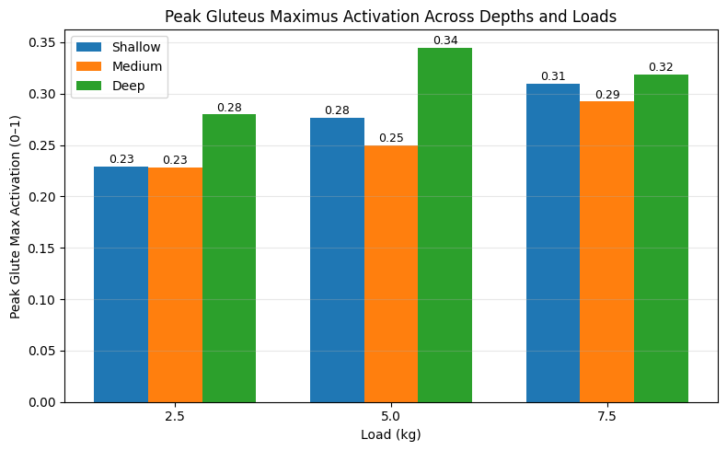
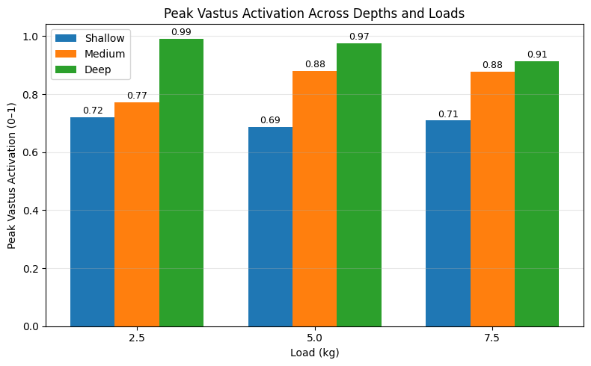
Results
Vid 1. Deep Squat
Fig 7. Peak Muscle Activation Across Loads and Depths (Gluteus Maximus & Vastus)
Conclusions (so far)
Vid 2. Medium Squat
Hip joint moments scale strongly with load, but knee moments show weak or inconsistent load dependence.
Glute activation increases with depth, with deep squats plateauing beyond ~5 kg.
Vastus activation is load-sensitive in medium depth but largely unchanged in shallow depth.
Overall, medium to deep squat depth and heavier weights provides the most balanced engagement of both gluteus maximus and vastus.
Vid 3. Shallow Squat
Hanif Rachmadani – z5715919

